Slide 1


Slide 2



A CAREER PLATFORM WHICH PROVIDES SUPPORT TO STUDENTS WHEN…
Company profiles
Job videos
Career events
Job offers on the JobTeaser network
Job offers exclusive to their university
An Advice module
Videos by recruitment specialists
Building their career path
Looking for an internship, placement or job
Preparing for interviews

Slide 3


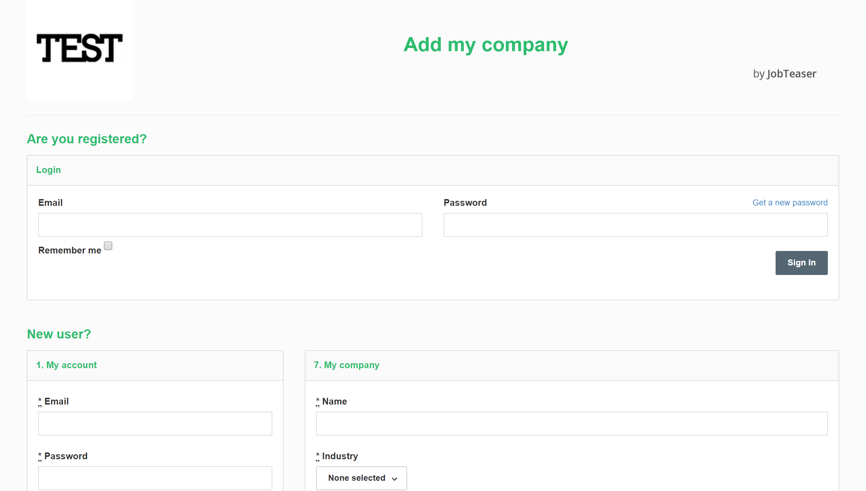
Test
Create an account by going to "New user?"
OR
Enter the email address and password linked to your company profile.
If you have forgotten your password, you can click on "Get a new password".
Follow the link : https://ju.jobteaser.com/en/sp_companies/users/new

Slide 4

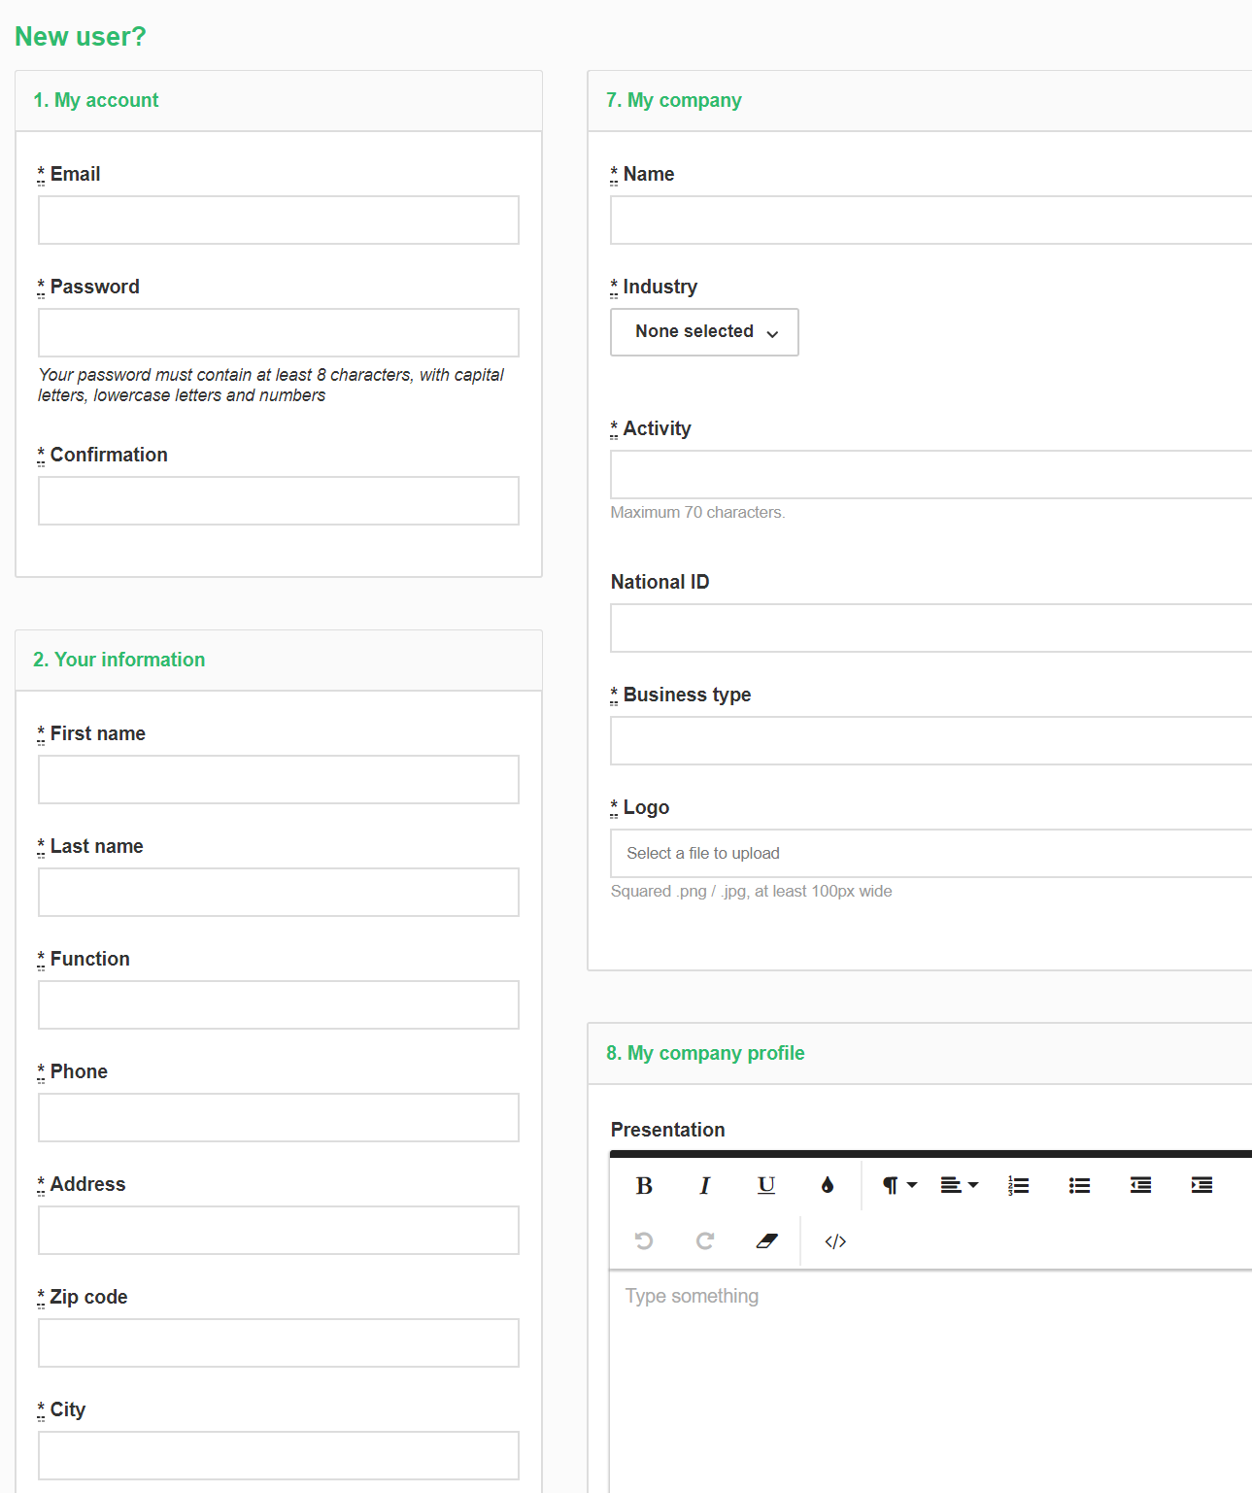
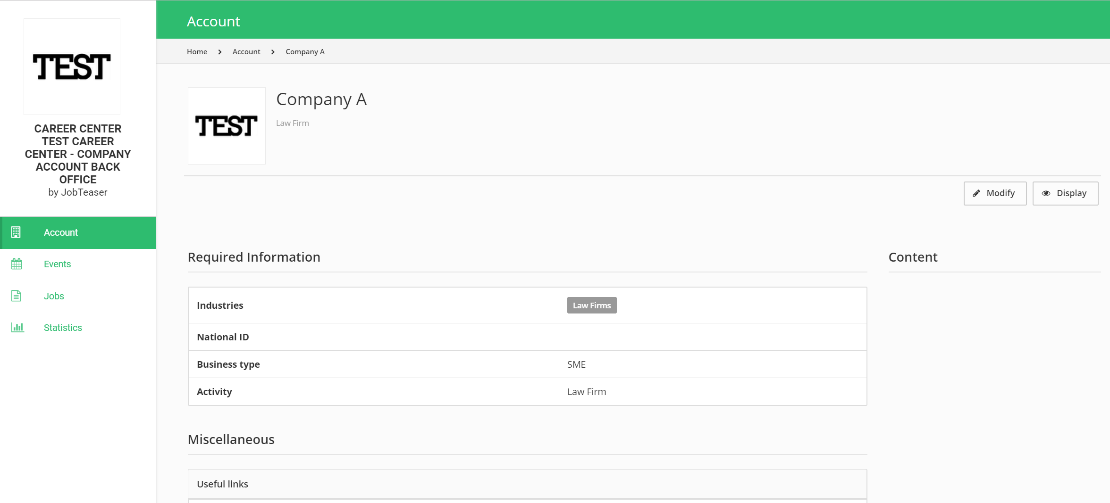
Update your details by clicking on “Modify".
Add your job offers by clicking on “Jobs" and then "Add a job offer".
Fill in all the mandatory details.
Click on "Create this company".
OR
The company profile is submitted for validation by the school.

Slide 5
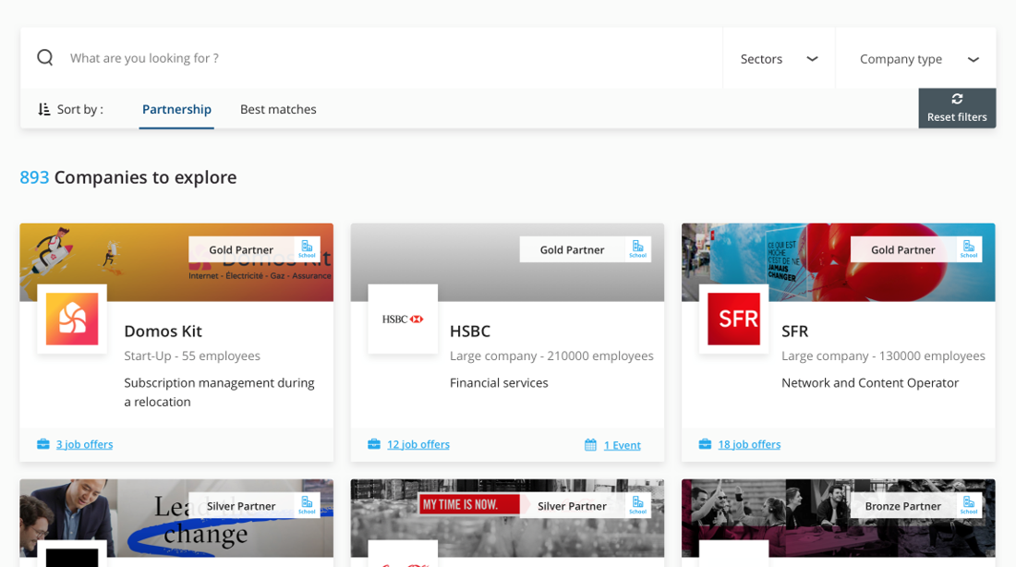
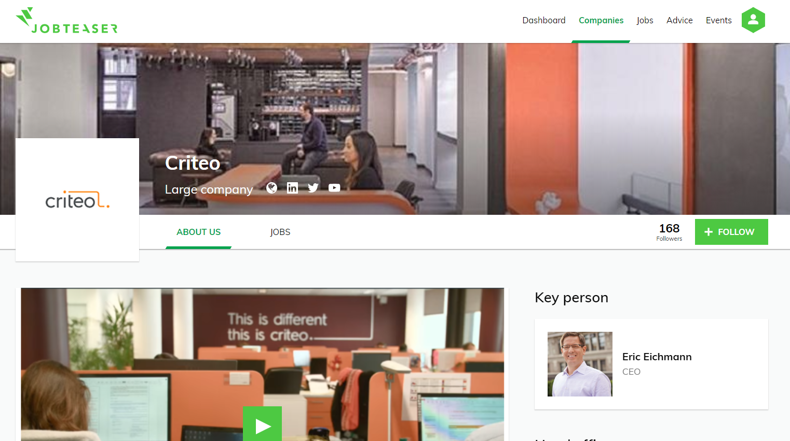
Once validated, the profile appears in the student's front office.
By clicking on the logo, the student can see all the information you’ve posted about the company.

Slide 6
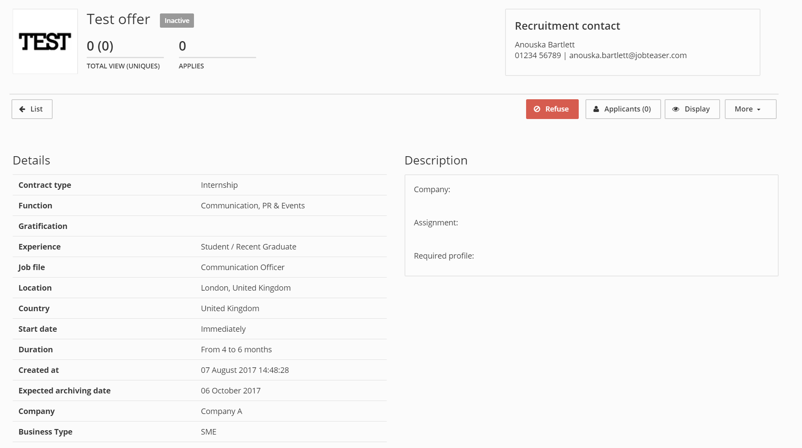
You can follow the number of views and clicks on your job offers as well as the number of applicants.
By clicking on "More", you can amend or archive your offer.

